Slide 1


David Church
May 12, 2022

Slide 2

Outline
Executive Summary
Introduction
Methodology
Results
Conclusion
Appendix

Slide 3
Executive Summary
Data on SpaceX launch results was obtained through use of the SpaceX API.
Additional data was web scrapped from SpaceX Wikipedia tables to from the full data set of SpaceX launch results.
The retrieved data was processed and then used to preform exploratory data analysis (EDA) using SQL and various visualization techniques.
Several classification models where trained and optimized using GridSearchCV allowing for predictive analysis of whether a rocket launch will have a successful landing.
The predictive model was developed with an accuracy of 83%.

Slide 4
Introduction
Private space company SpaceX has found tremendous success in reducing cost per rocket launch by landing the first stage of their Falcon9 rockets allowing for re-use of the most expensive portion of the launch.
Using data science techniques, we aim to analyze past SpaceX launch data to gain insights and build a model to determine whether or not a rocket will land successfully.
Using these models SpaceY will be able to accelerate the success of our own rocket re-use program making us a viable competitor to SpaceX.

Slide 5

Section 1

Slide 6
Methodology
Data collection methodology:
Data was collected via SpaceX API and Data wrangling from Wikipedia tables
Perform data wrangling:
The different cases for the “landing_outcomes” column were parsed into success or failure
A new binary column called “Class” was then created with 0 representing a failure and 1 representing a success.
Perform exploratory data analysis (EDA) using visualization and SQL
Perform interactive visual analytics using Folium and Plotly Dash

Slide 7
Methodology
Perform predictive analysis using classification models:
The “Class” column was broken out from the data set as the dependent variable
The remaining columns were prepared for the analysis using the preprocessing function StandardScalar
The Data was broken into 2 groups for training and testing using the train_test_split function
Classification models were created using SVM, Classification Tree, and logistic regression with optimized parameters from the GridSearchCV function
The accuracy was determined for all classification models for both the training and test dataset

Slide 8
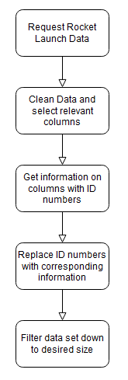
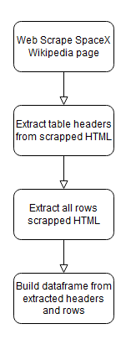
Data Collection
Method 1: API Collection
Collect basic data from SpaceX API “launches/past” endpoint
Normalize the data and create a dataframe
Remove un-needed rows (multi payload launches)
Access rockets, launchpads, payloads, cores endpoints
replace ID numbers from basic dataframe with new data
Clean and filter final dataframe
Method 2: Web Scrapping
Table is extracted from Wikipedia page
Column headers are pulled from the HTML to create a new list
New lists for each column are created for every row in the table
The header list and the lists for all columns are combined into a final dataframe

Slide 9
Data Collection – SpaceX API
API Endpoints called:
https://api.spacexdata.com/v4/launches/past
https://api.spacexdata.com/v4/rockets/
https://api.spacexdata.com/v4/launchpads/
https://api.spacexdata.com/v4/payloads/
https://api.spacexdata.com/v4/cores/
API Data was consolidated to a single dataframe
Unwanted rows (i.e. multiple payload and launches with more than 1 booster) were removed from the data set
Link for peer review:
https://github.com/lavaxv123/IBM-Data-Science-Capstone/blob/main/jupyter-labs-spacex-data-collection-api.ipynb

Slide 10
Data Collection - Scraping
Python requests module was used to get the HTML code for the SpaceX launches Wikipedia page.
Using the HTML code, a Beautiful Soup object was created.
Using the “find_all” function, the tables were broken out into a list called html_tables.
From this new list we select the table to be extracted and assign it to a new variable.
The headers are then extracted into a new list, followed by extracting each column into its own list.
These lists are then combined into the final dataframe for the scraped data.
Link for peer review:
https://github.com/lavaxv123/IBM-Data-Science-Capstone/blob/main/jupyter-labs-webscraping.ipynb

Slide 11
Data Wrangling
The sum of the null values in each column was calculated and showed 5 nulls in the PayloadMass column and 26 null values in the LandingPad column.
We replace the null values in the PayloadMass column with the average payload mass for the entire dataset leaving the dataframe with only null values for the LandingPad column.
The unique Outcomes are found and then looped through with a ‘for’ loop in order to separate the bad outcomes from the good ones.
A new list called landing_class is created and for every outcome in the dataframe, if the “Outcome” field exists in the list of bad outcomes, a value of 0 will be appended to the new landing_class list. Otherwise a 1 will be appended.
This new list is then added as a new column to the dataframe called “Class”.
This allows the data to easily show weather one of 8 possible outcomes is a success or failure with a binary column.
Link for peer review:
https://github.com/lavaxv123/IBM-Data-Science-Capstone/blob/main/labs-jupyter-spacex-Data%20wrangling.ipynb

Slide 12
EDA with Data Visualization
To compare various variables and their effects on success rate of the rocket landings various charts were created.
Five scatterplots were created:
Payload Mass vs. Flight Number
Launch Site vs Flight Number
Launch Site vs Payload Mass
Orbit vs Flight Number
Orbit vs Payload Mass
One bar graph was created:
Landing Success Rate vs Orbit
Link for peer review:
https://github.com/lavaxv123/IBM-Data-Science-Capstone/blob/main/jupyter-labs-eda-dataviz.ipynb

Slide 13
EDA with SQL
Task 1: Uses a Select distinct query to get the unique set of launch sites
Task 2: Query uses select * with a where clause for strings beginning with ‘CCA’
Task 3: Select query for the sum of ‘Payload_Mass__KG_’ where customer is ‘NASA (CRS)’
Task 4: Query uses select avg, with a where clause for the desired booster version
Task 5: Select query on the min(date), with a where clause on the desired landing outcome
Task 6: Select query with a where clause using an “and” clause to filter on 2 criteria
Task 7: Select query using ‘group by’ clause to sort on mission_outcome
Task 8: Use a sub query filter the where clause on payloads that equal the maximum payload
Task 9: Use a select query with a where clause and 3 criteria to filter on
Task 10: Select query with a where clause, group by clause, and order by DESC clause
Link for peer review:
https://github.com/lavaxv123/IBM-Data-Science-Capstone/blob/main/jupyter-labs-eda-sql-coursera.ipynb

Slide 14
Build an Interactive Map with Folium
Each of the four launch sites have several markers indicating them:
A large circle surrounding the immediate area of the launch site
If the large circle is clicked, on an annotation with the launch site name will appear
A cluster marker to group all nearby markers together when the map is sufficiently zoomed out
Each cluster marker has a number of colored markers either red or green depending on whether the landing attempt is a success or a failure
There are 2 polylines, one from a launch site to the nearest coast, and another from a launch site to the nearest railroad
Link for peer review:
https://github.com/lavaxv123/IBM-Data-Science-Capstone/blob/main/lab_jupyter_launch_site_location.ipynb

Slide 15
Build a Dashboard with Plotly Dash
The interactive Plotly dashboard utilizes 2 charts and 2 filters.
An interactive Pie chart was added that shows the percentage of successes that occur at a given launch site. A dropdown filter for the launch site can be used to get the success rate for a given launch site.
This Pie chart helps to determine if certain launch site have greater success of landing rockets than others.
A scatterplot comparing the successes against the payload mass, with the data points being colored according to the booster version. There is a payload mass slider to filter the data in the scatterplot to different payload ranges. The launch site filter also applies to the scatterplot.
Link for peer review:
https://github.com/lavaxv123/IBM-Data-Science-Capstone/blob/main/spacex_dash_app.py

Slide 16
Predictive Analysis (Classification)
The data was broken into feature set X and the target variable ‘Class’ as Y.
The feature set is standardized using the preprocessing.StandardScaler function.
The data set is then split into a training set and a test set using train_test_split with a test size of 0.2.
The GridSearchCV function was used to find the optimal parameters and fit for 4 different classification models (logistic regression, SVC, decision tree, KNN).
The accuracy was determined for each of the models, using both the training data and the test data.
A confusion matrix was created using the test data for each of the models.
Link for peer review:
https://github.com/lavaxv123/IBM-Data-Science-Capstone/blob/main/SpaceX_Machine%20Learning%20Prediction_Part_5.ipynb

Slide 17
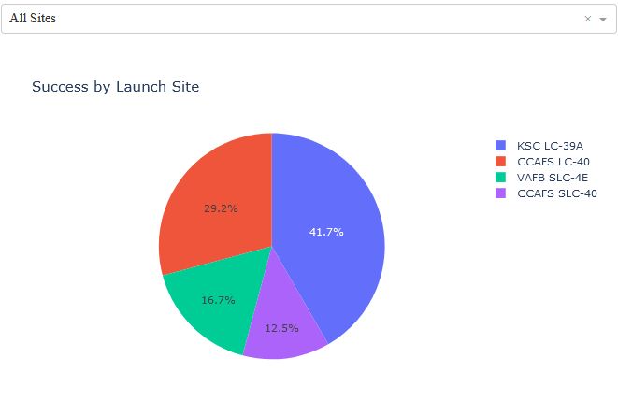
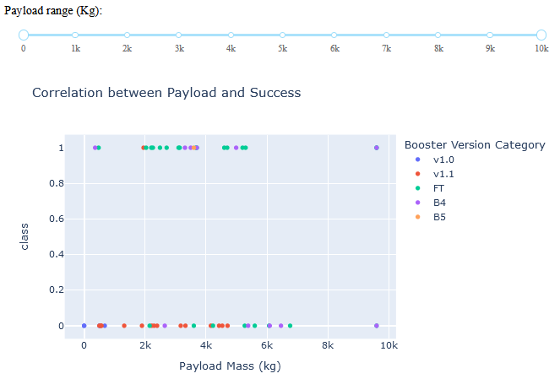
Results
Through the use of exploratory data analysis, it was found that as the flight number increases the success rate of landing the rocket does as well.
Launch site KSC LC-39A has the highest success rate of all launch sites at 76.9%.
All four classification models that were trained had the same test accuracy at 83.33%, and the best model taking into account the training accuracy is a decision tree with an accuracy of 87.5%.

Slide 18

Section 2

Slide 19
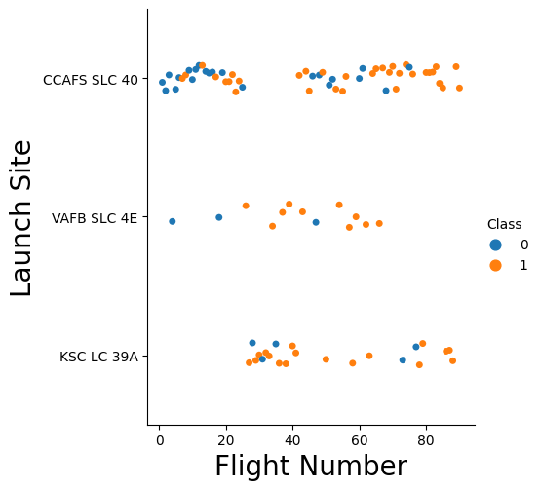
Flight Number vs. Launch Site
Launch site CCAFS SLC 40 is the most commonly used launch site.
Launch site KSC LC 39A didn’t begin use until after the 20th flight.
The majority of the earlier flights had landing failures, whereas the majority of the later flights ended with landing success.

Slide 20
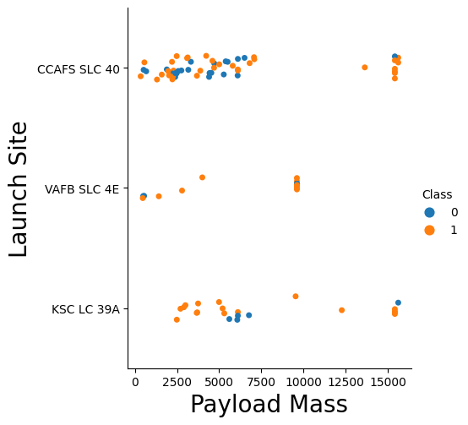
Payload vs. Launch Site
The CCAFS SLC 40 launch site has a large gap in between its low payload launches and high payload launches.
Larger payload masses seem to have higher chances for successful landing.
VAFB SLC 4E doesn’t launch rockets with payload mass of greater than 10,000 kg.

Slide 21
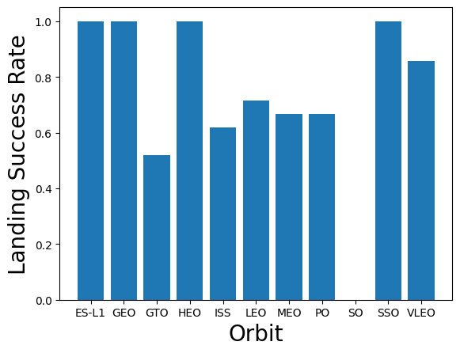
Success Rate vs. Orbit Type
Orbits have either a high success rate near 100% or a medium level success rate near 60%.
SO orbit is an outlier with 0% success rate.

Slide 22
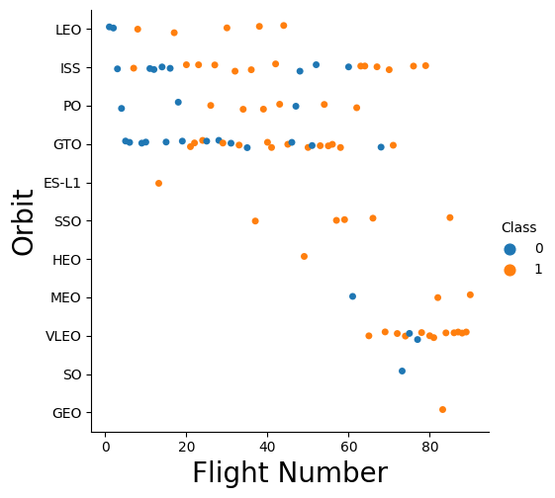
Flight Number vs. Orbit Type
The most common orbit types are (LEO, ISS, PO, GTO, VLEO), and other orbit types don’t have a significant enough number of launches to determine success rate.
Launches to VLEO only occurred after 60 flights meaning success rate for this orbit type may be skewed towards success.

Slide 23
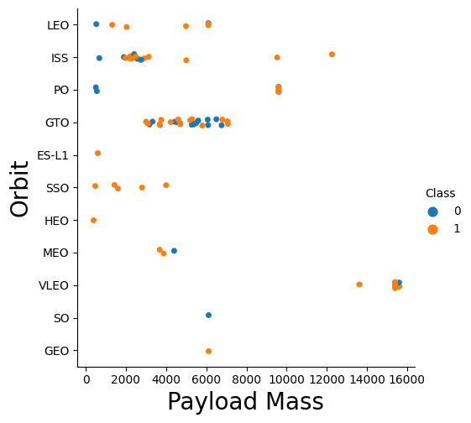
Payload vs. Orbit Type
Typical rocket launches carry payloads with under 8,000 kg mass.
VLEO is an outlier with all of the payloads sitting around 16,000 kg mass

Slide 24
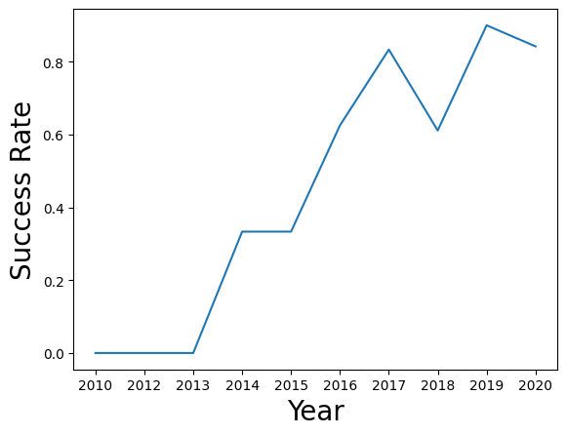
Launch Success Yearly Trend
It took several years before landing a rocket became successful. Years 2010 through 2013 had a 0% success rate.
The general trend of the launch success rate is positive. This seems to agree with the earlier observation that success rate increases with flight number.

Slide 25
All Launch Site Names
Launch_site
CCAFS LC-40
VAFB SLC-4E
KSC LC-39A
CCAFS SLC-40
The table to pull the unique launch site values was pulled from the MySQL database with the following query:
select distinct Launch_site from spacex

Slide 26
Launch Site Names Begin with 'CCA'
The following query uses the wildcard operator ‘%’ to pull records where launch site name begins with ‘CCA’:
select * from spacex where Launch_Site like 'CCA%' limit 5;
Date | Time (UTC) | Booster_Version | Launch_Site | Payload | PAYLOAD_MASS__KG_ | Orbit | Customer | Mission_Outcome | Landing _Outcome
2010-06-04 | 18:45:00 | F9 v1.0 B0003 | CCAFS LC-40 | Dragon Spacecraft Qualification Unit | 0 | LEO | SpaceX | Success | Failure (parachute)
2010-12-08 | 15:43:00 | F9 v1.0 B0004 | CCAFS LC-40 | Dragon demo flight C1, two CubeSats, barrel of Brouere cheese | 0 | LEO (ISS) | NASA (COTS) NRO | Success | Failure (parachute)
2012-05-22 | 7:44:00 | F9 v1.0 B0005 | CCAFS LC-40 | Dragon demo flight C2 | 525 | LEO (ISS) | NASA (COTS) | Success | No attempt
2012-10-08 | 0:35:00 | F9 v1.0 B0006 | CCAFS LC-40 | SpaceX CRS-1 | 500 | LEO (ISS) | NASA (CRS) | Success | No attempt
2013-03-01 | 15:10:00 | F9 v1.0 B0007 | CCAFS LC-40 | SpaceX CRS-2 | 677 | LEO (ISS) | NASA (CRS) | Success | No attempt

Slide 27
Total Payload Mass
Using the aggregate function SUM to sum all of the payload masses and a where function to filter the following query produces a table with the total sum of payload mass 45,596 kg:
select SUM(Payload_Mass__KG_) from spacex where Customer ='NASA (CRS)';

Slide 28
Average Payload Mass by F9 v1.1
Using the average function AVG to average all of the payload masses and a where function to filter the following query produces a table with the average payload mass 2,928 kg:
select avg(Payload_Mass__KG_) from spacex where booster_version = 'F9 v1.1';

Slide 29
First Successful Ground Landing Date
The Min function was used to get the earliest date alongside the where function to filter on the desired landing outcome to find 2015-12-22 as the earliest successful ground pad landing.
select min(date) from spacex where Landing_Outcome = 'Success (ground pad)';

Slide 30
Successful Drone Ship Landing with Payload between 4000 and 6000
booster_version
F9 FT B1021.1
F9 FT B1022
F9 FT B1023.1
F9 FT B1026
F9 FT B1029.1
F9 FT B1021.2
F9 FT B1029.2
F9 FT B1036.1
F9 FT B1038.1
F9 B4 B1041.1
F9 FT B1031.2
F9 B4 B1042.1
F9 B4 B1045.1
F9 B5 B1046.1
A where function was used to filter the query down, using the ‘and’ statement to have 2 criteria to filter on.
select booster_version from spacex where landing_outcome = 'Success (drone ship)' and (4000 < payload_mass__kg_ < 6000);

Slide 31
Total Number of Successful and Failure Mission Outcomes
This query uses the count function to return the number of rows, using ‘group by’ to group the distinct mission_outcome’s together.
select mission_outcome, count(*) as NUM from spacex group by mission_outcome;
mission_outcome | NUM
Success | 98
Failure (in flight) | 1
Success (payload status unclear) | 1
Success | 1

Slide 32
Boosters Carried Maximum Payload
The distinct function is used to get only the unique boosters and then the query is filtered with a where clause. In order to get maximum payload mass for the where clause, a sub query using the max function is used.
select distinct(Booster_version) from spacex where payload_mass__kg_ = (select max(payload_mass__kg_) from spacex);
Booster_version
F9 B5 B1048.4
F9 B5 B1049.4
F9 B5 B1051.3
F9 B5 B1056.4
F9 B5 B1048.5
F9 B5 B1051.4
F9 B5 B1049.5
F9 B5 B1060.2
F9 B5 B1058.3
F9 B5 B1051.6
F9 B5 B1060.3
F9 B5 B1049.7

Slide 33
2015 Launch Records
This query uses a where clause with double sided wild cards for 2 of the criteria. The third criteria uses the ‘year’ function to pull the year from the date column.
select landing_outcome, booster_version, launch_site from spacex where year(date)=2015 and mission_outcome like '%Failure%' and landing_outcome like '%drone%';
landing_outcome | booster_version | launch_site
Precluded (drone ship) | F9 v1.1 B1018 | CCAFS LC-40

Slide 34
Rank Landing Outcomes Between 2010-06-04 and 2017-03-20
This query uses the count function to count all the records and a where clause is used to specify the date range. The records are then grouped by the landing outcome and ordered by the total counts in descending order.
select landing_outcome, count(*) as NUM from spacex where '2010-06-04'< Date < '2017-03-20' group by landing_outcome order by NUM DESC;
landing_outcome | NUM
Success | 38
No attempt | 21
Success (drone ship) | 14
Success (ground pad) | 9
Controlled (ocean) | 5
Failure (drone ship) | 5
Failure | 3
Failure (parachute) | 2
Uncontrolled (ocean) | 2
Precluded (drone ship) | 1
No attempt | 1

Slide 35

Section 3

Slide 36
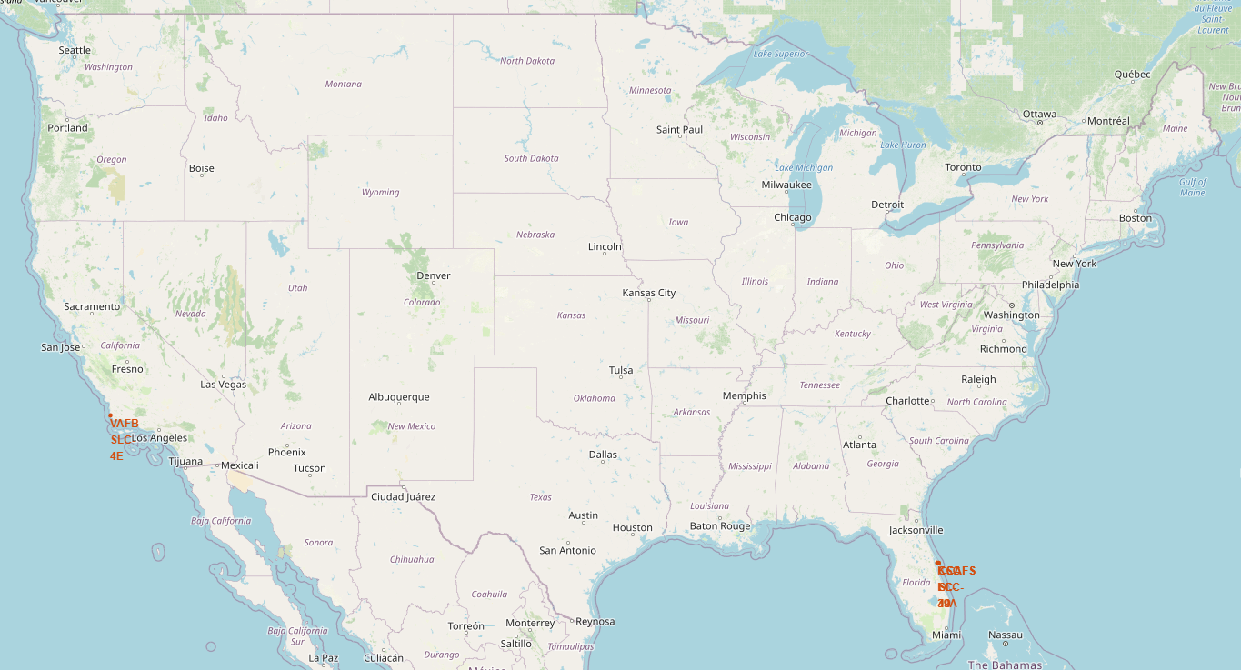
Launch Site Locations
All launch site locations are shown on this map of the United States.
Launch site’s are only present in California and Florida.
All launch sites are by the coast.

Slide 37
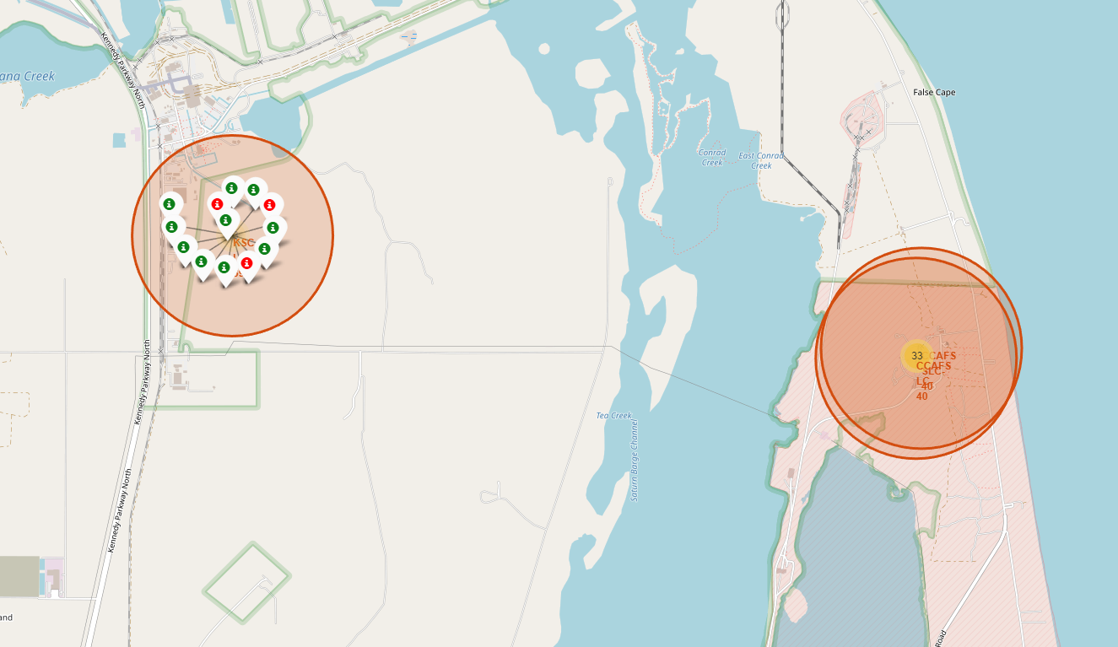
Launch Outcome Markers
The 3 launch sites in Florida are show on the map to the right.
In the interactive map, there are colored markers to help visualize the launch outcomes at each launch site.
As you click on the launch site the markers will appear, and as you click off the disappear.

Slide 38
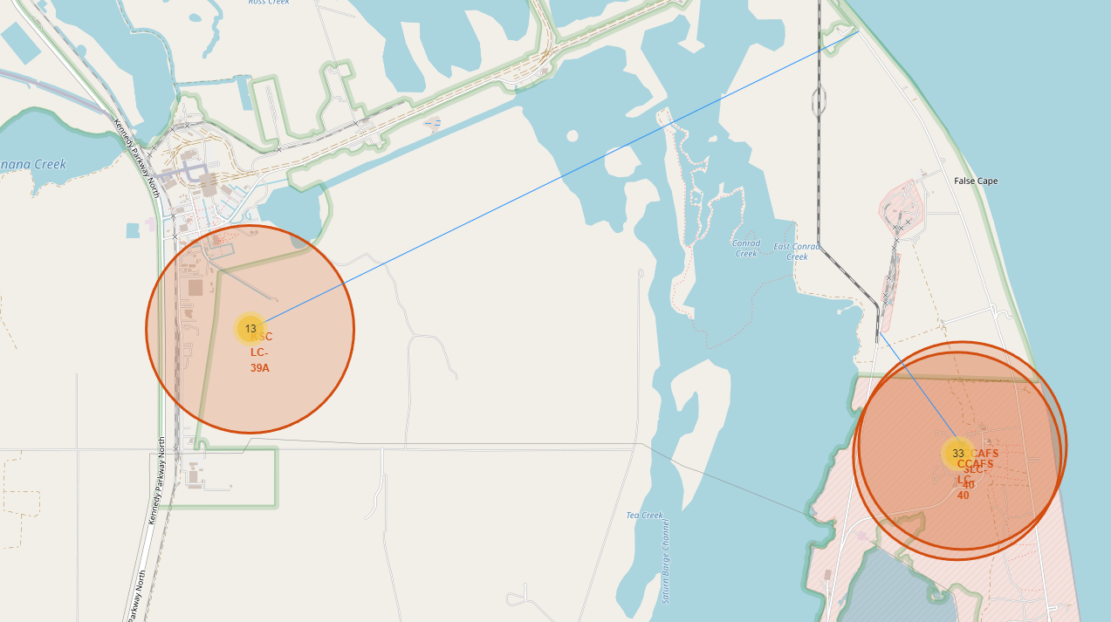
Folium’s Polylines
Launch site KSC LC-39A has a polyline going from the launch site to the shore.
Launch site CCAFS SLC-40 has a polyline going from the launch site to the nearby railroad.

Slide 39

Section 4

Slide 40
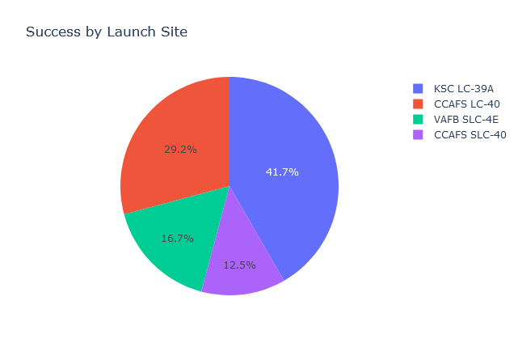
Launch Site Success Rates
Out of all successful landing the vast majority are split between KSC LC-39A and CCAFS LC-40.

Slide 41
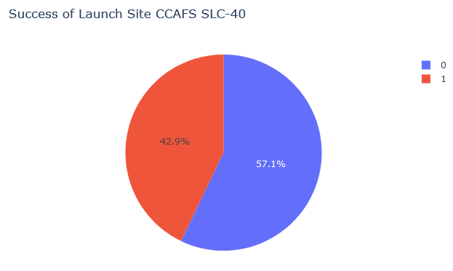
Highest Launch Site Landing Percent
The launch site had the highest landing success rate.
The success rate of this launch site is 42.9%.

Slide 42
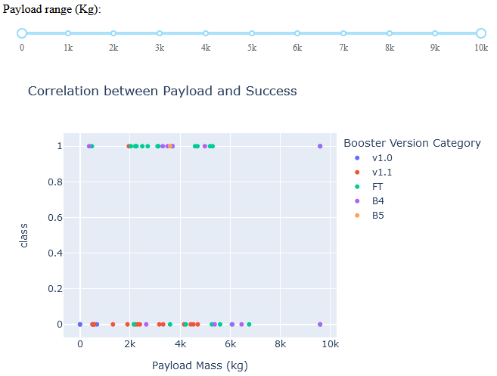
Success by Payload Mass
The slider on the top can filter the visual based on the payload mass.
The visual shows the successes for different payload mass, color coded based on the booster version.

Slide 43

Section 5

Slide 44
Classification Accuracy
Each model had the same test accuracy at 83.3 %.
The Decision Tree Model had the highest training accuracy at 87.5%
Model | Data | Accuracy
Logistic Regression | Training | 84.6%
Logistic Regression | Test | 83.3%
SVM | Training | 84.8%
SVM | Test | 83.3%
Decision Tree | Training | 87.5%
Decision Tree | Test | 83.3%
K Nearest Neighbor | Training | 84.8%
K Nearest Neighbor | Test | 83.3%

Slide 45
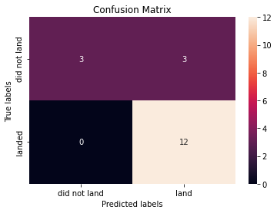
Confusion Matrix
This model had a problem with false positives.
Out of all the cases in the test set, there where 3 false positives and the rest of the results were true positives.

Slide 46
Conclusions
Every since 2013 SpaceX has had a positive trend for launch success rate peaking in 2019 at 90%.
The majority of the launches occur with a payload mass of under 10,000 kg and an average launch mass of 2,928 kg.
Launch site KSC LC-39A has the highest number of successful landings, however the site with the highest success rate is CCAFS SLC-40 with 42.9%.
With the optimized parameters that were tested, all 4 of the models that were trained had the same test accuracy at 83.3%. The Decision Tree model had the best training accuracy at 87.5%.
All models had an bias with false positives and no false negatives.

Slide 47
Appendix
GitHub repository link:
https://github.com/lavaxv123/IBM-Data-Science-Capstone

Slide 48


